Slide 1
Matplotlib

Slide 2
Matplotlib
matplotlib is a python 2D plotting library which produces quality figures in a variety of hardcopy
http://matplotlib.sourceforge.net/

Slide 3
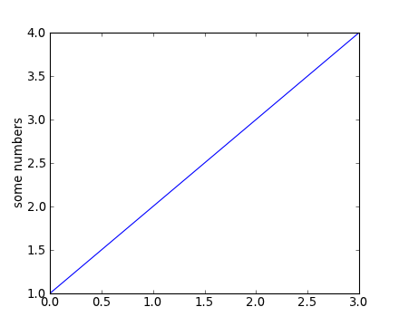
Matplotlib
Simple Plot. The most basic plot(), with text labels
import matplotlib.pyplot as plt
plt.plot([1,2,3,4])‏
plt.ylabel('some numbers')‏
plt.show()‏

Slide 4
Matplotlib
plot() is a versatile command, and will take an arbitrary number of arguments. For example, to plot x versus y, you can issue the command:
plt.plot([1,2,3,4], [1,4,9,16])‏
there is an optional third argument which is the format string that indicates the color and line type of the plot.

Slide 5
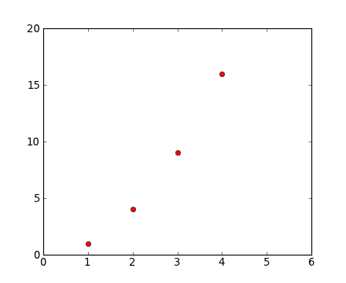
Matplotlib
import matplotlib.pyplot as plt
plt.plot([1,2,3,4], [1,4,9,16], 'ro')‏
plt.axis([0, 6, 0, 20])‏
plt.show()‏

Slide 6
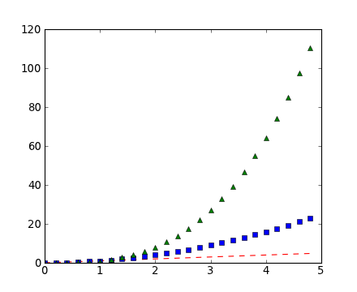
Matplotlib
import matplotlib.pyplot as plt
t= [float(x)/10.0 for x in range(0,50,2)]
t2=[x**2 for x in t]
t3=[x**3 for x in t]
plt.plot(t,t,'r--', t,t2,'bs', t,t3,'g^')‏
plt.show()‏

Slide 7
Matplotlib:
Working with multiple figures and axes
import matplotlib.pyplot as plt
plt.figure(1) # the first figure
plt.subplot(211) # the first subplot in the first figure
plt.plot([1,2,3])‏
plt.subplot(212) # the second subplot in the first figure
plt.plot([4,5,6])‏
plt.figure(2) # a second figure
plt.plot([4,5,6]) # creates a subplot(111) by default
plt.figure(1) # figure 1 current; subplot(212) still current
plt.subplot(211) # make subplot(211) in figure1 current
plt.title('Easy as 1,2,3') # subplot 211 title
plt.show()‏

Slide 8
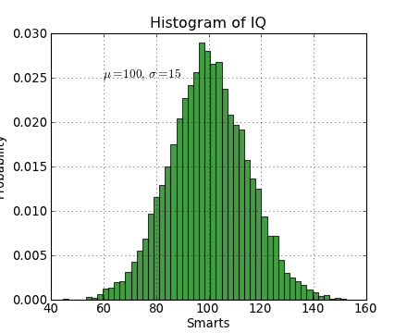
Matplotlib:
working with text
import numpy as np
import matplotlib.pyplot as plt
mu, sigma = 100, 15
x = mu + sigma * np.random.randn(10000)‏
# the histogram of the data
n, bins, patches = plt.hist(x, 50, normed=1, facecolor='g', alpha=0.75)‏
plt.xlabel('Smarts')‏
plt.ylabel('Probability')‏
plt.title('Histogram of IQ')‏
plt.text(60,.025, r'$\mu=100,\ \sigma=15$')‏
plt.axis([40, 160, 0, 0.03])‏
plt.grid(True)‏
plt.show()‏

